Slide 1
Knowledge and reasoning – second part
Knowledge representation
Logic and representation
Propositional (Boolean) logic
Normal forms
Inference in propositional logic
Wumpus world example

Slide 2
Knowledge-Based Agent
Agent that uses prior or acquired knowledge to achieve its goals
  Can make more efficient decisions
  Can make informed decisions
Knowledge Base (KB): contains a set of representations of facts about the Agent’s environment
Each representation is called a sentence
Use some knowledge representation language, to TELL it what to know e.g., (temperature 72F)
ASK agent to query what to do
Agent can use inference to deduce new facts from TELLed facts
Domain independent algorithms
ASK
Inference engine
TELL
Knowledge Base
Domain specific content

Slide 3
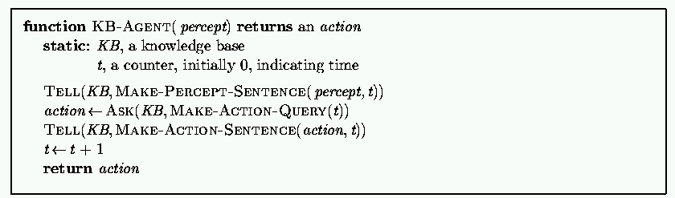
Generic knowledge-based agent
TELL KB what was perceived
Uses a KRL to insert new sentences, representations of facts, into KB
ASK KB what to do.
Uses logical reasoning to examine actions and select best.

Slide 4
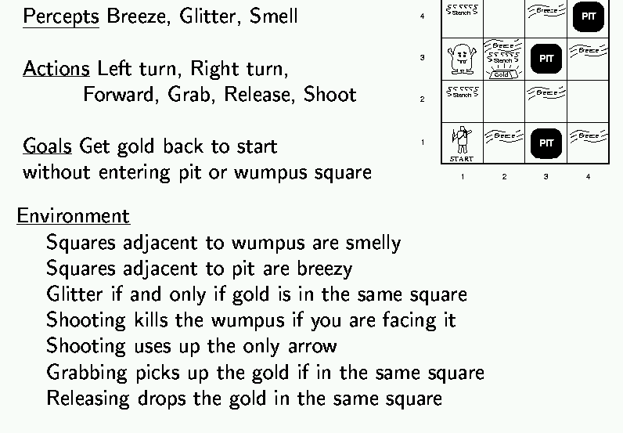
Wumpus world example

Slide 5
Wumpus world characterization
Deterministic?
Accessible?
Static?
Discrete?
Episodic?

Slide 6
Wumpus world characterization
Deterministic? Yes – outcome exactly specified.
Accessible? No – only local perception.
Static? Yes – Wumpus and pits do not move.
Discrete? Yes
Episodic? (Yes) – because static.

Slide 7
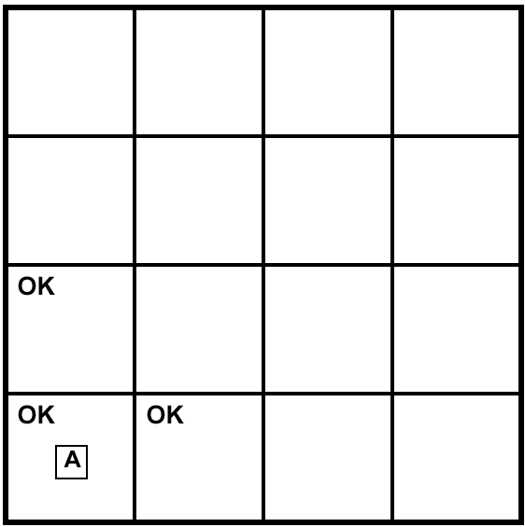
Exploring a Wumpus world

Slide 8

Exploring a Wumpus world

Slide 9
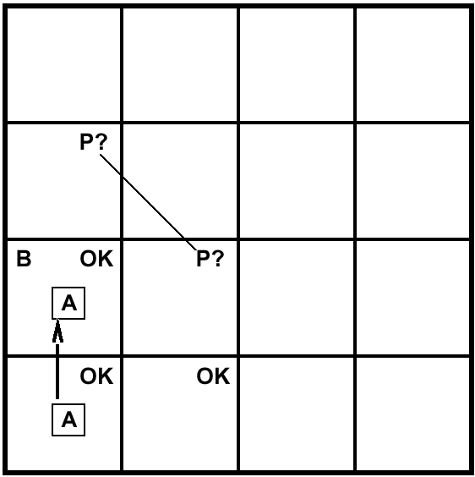
Exploring a Wumpus world

Slide 10
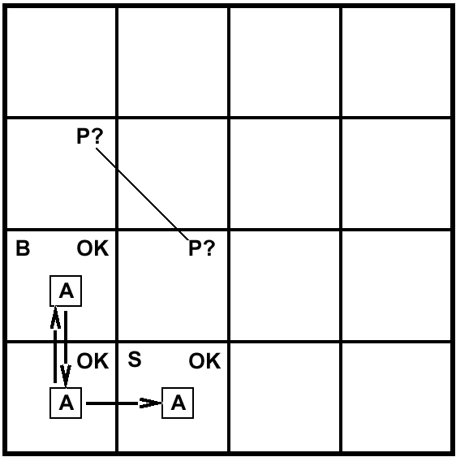
Exploring a Wumpus world

Slide 11
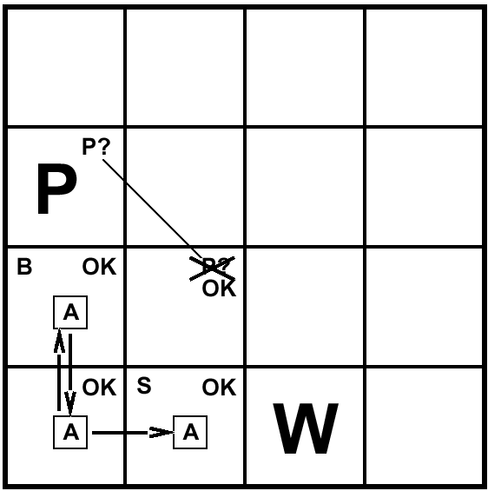
Exploring a Wumpus world

Slide 12

Exploring a Wumpus world

Slide 13
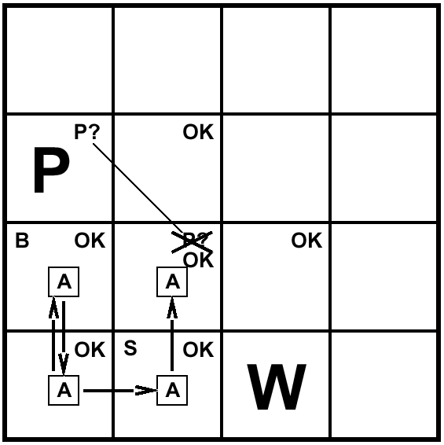
Exploring a Wumpus world

Slide 14
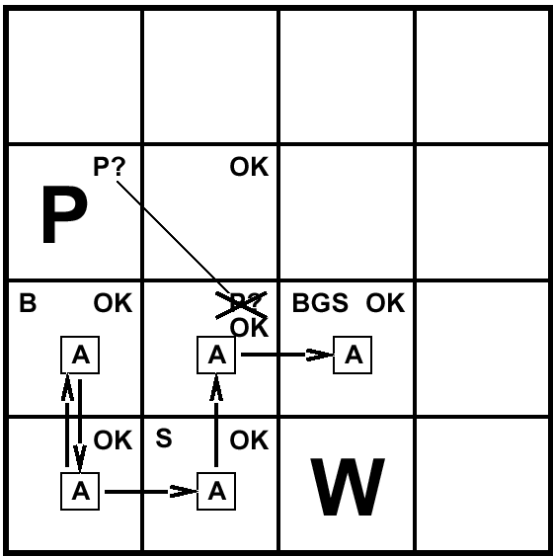
Exploring a Wumpus world

Slide 15
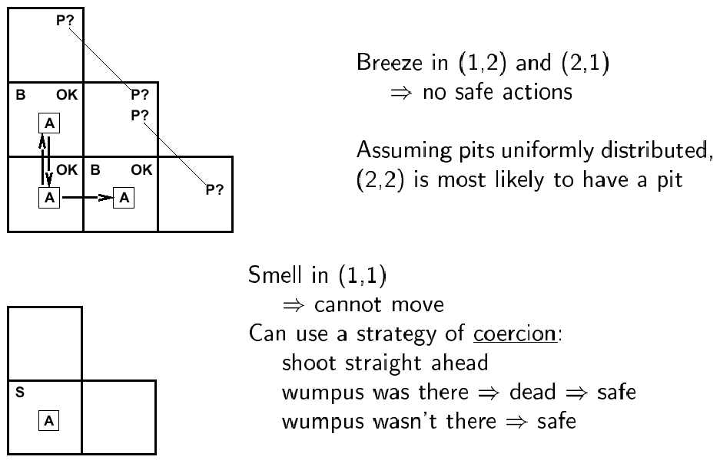
Other tight spots

Slide 16
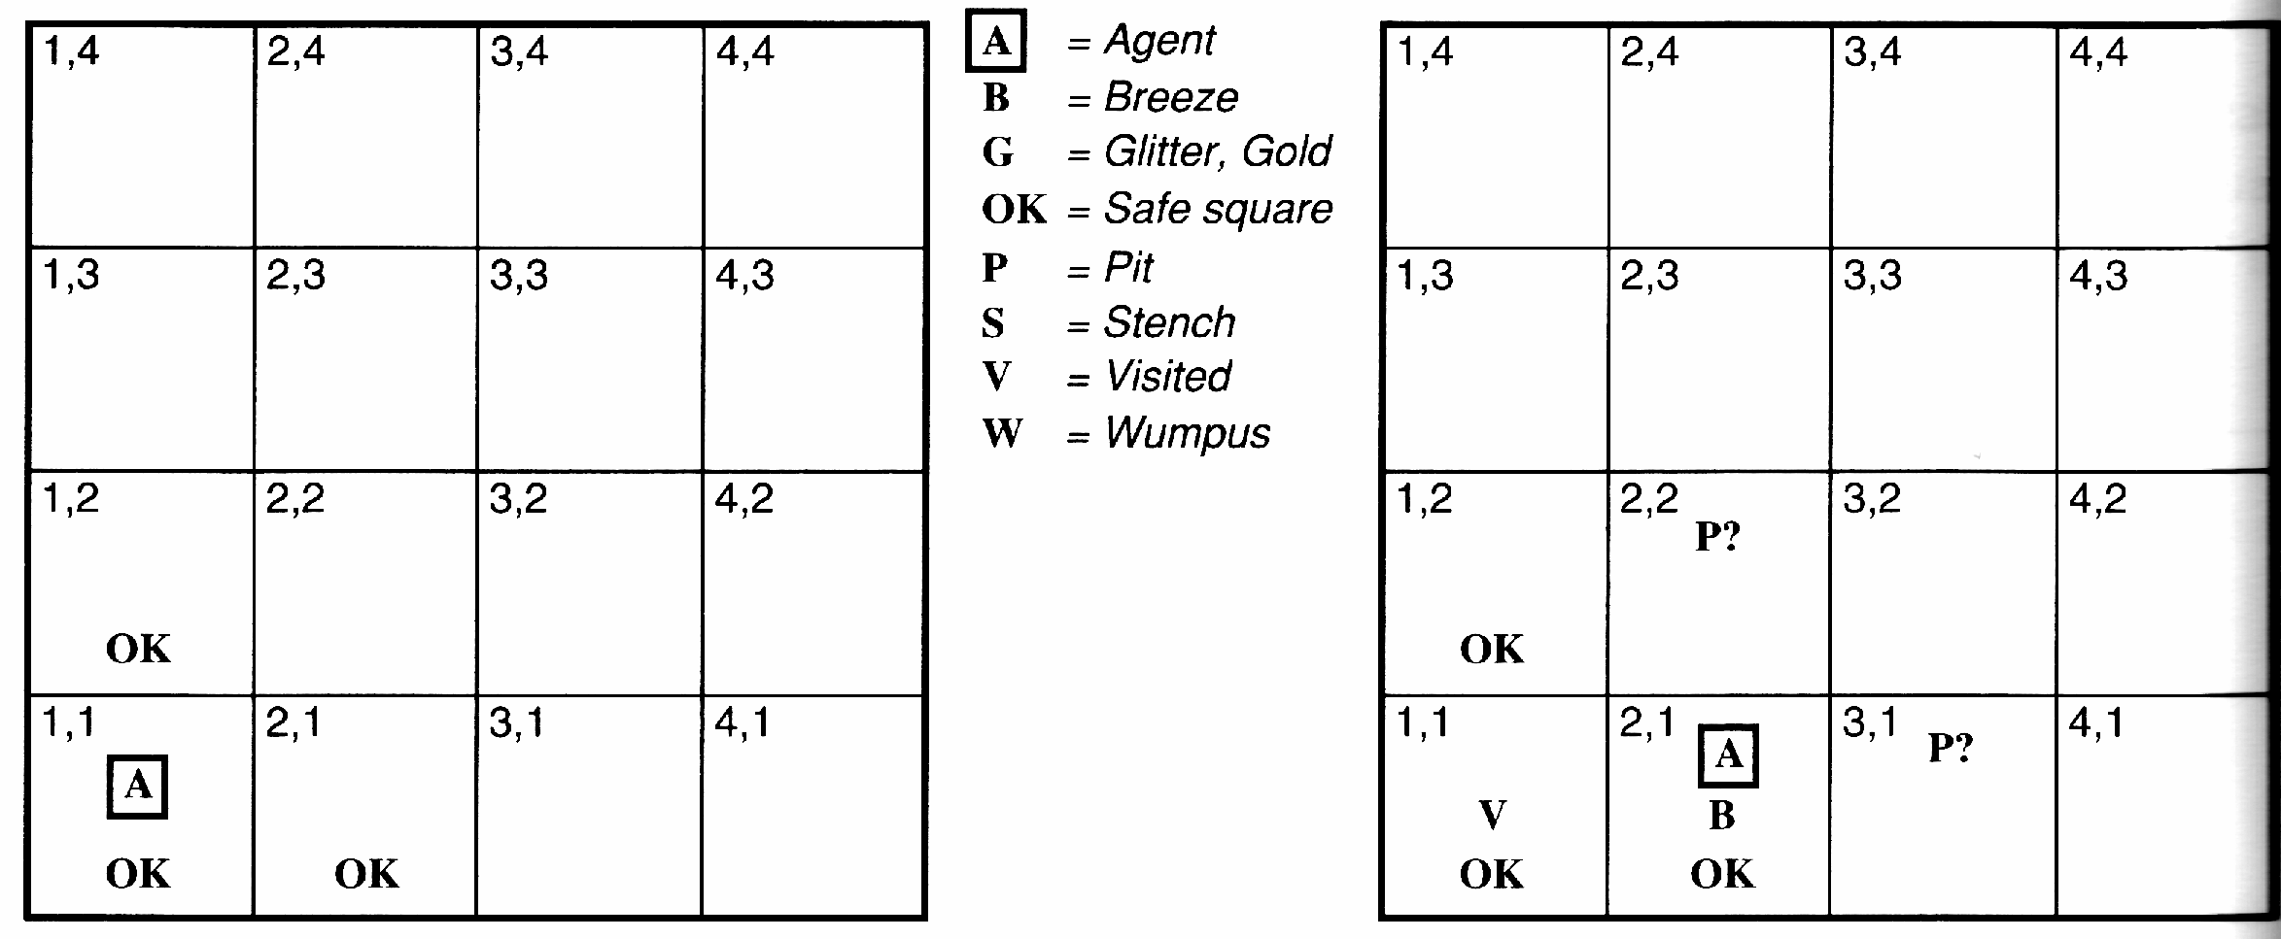
Another example solution
No perception → 1,2 and 2,1 OK
Move to 2,1
B in 2,1 → 2,2 or 3,1 P?
1,1 V → no P in 1,1
Move to 1,2 (only option)

Slide 17
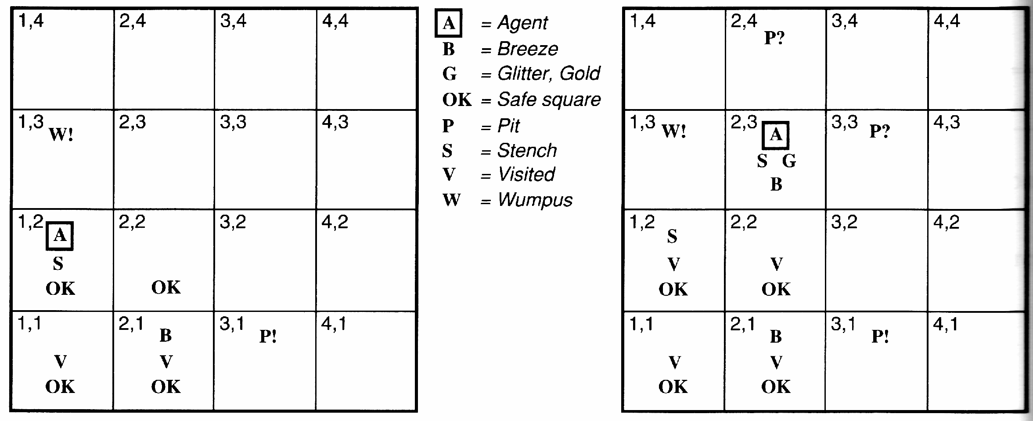
Example solution
S and No S when in 2,1 → 1,3 or 1,2 has W
1,2 OK → 1,3 W
No B in 1,2 → 2,2 OK & 3,1 P

Slide 18
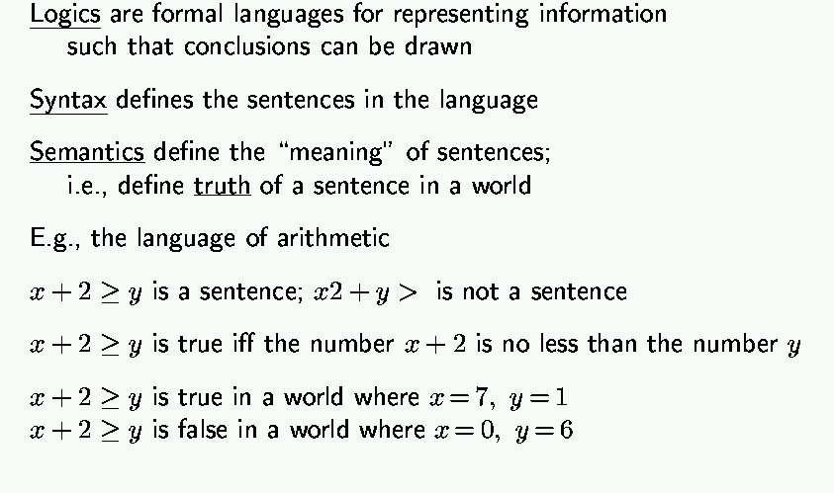
Logic in general

Slide 19
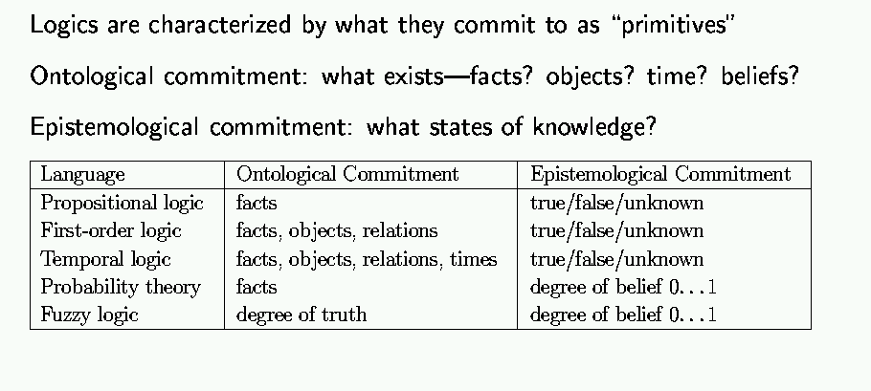
Types of logic

Slide 20
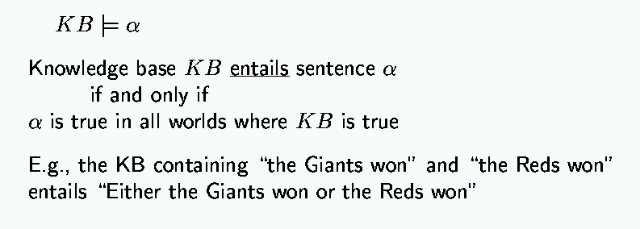
Entailment

Slide 21
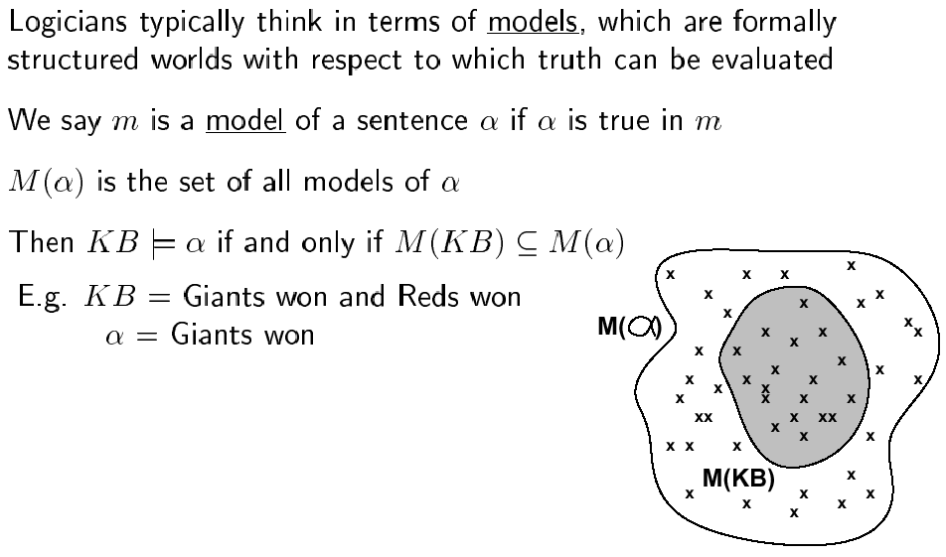
Models

Slide 22
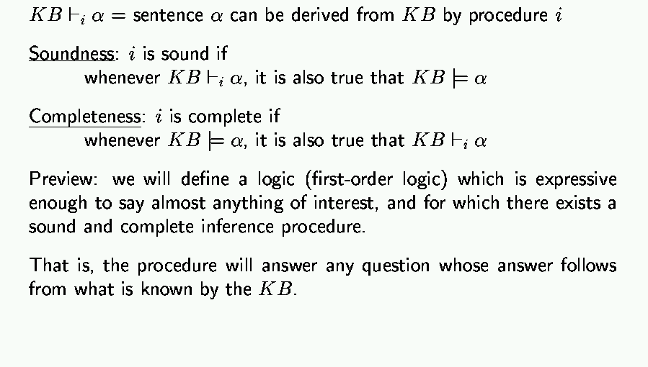
Inference

Slide 23
Basic symbols
Expressions only evaluate to either “true” or “false.”
P “P is true”
¬P “P is false” negation
P V Q “either P is true or Q is true or both” disjunction
P ^ Q “both P and Q are true” conjunction
P => Q “if P is true, the Q is true” implication
P ⬄ Q “P and Q are either both true or both false” equivalence

Slide 24
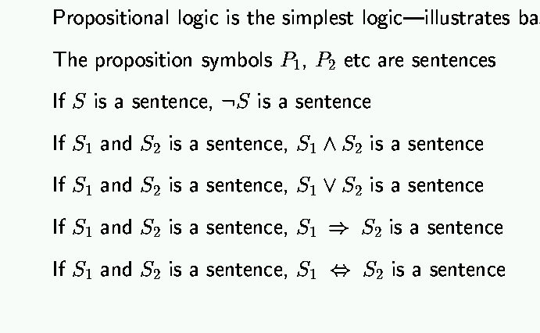
Propositional logic: syntax

Slide 25
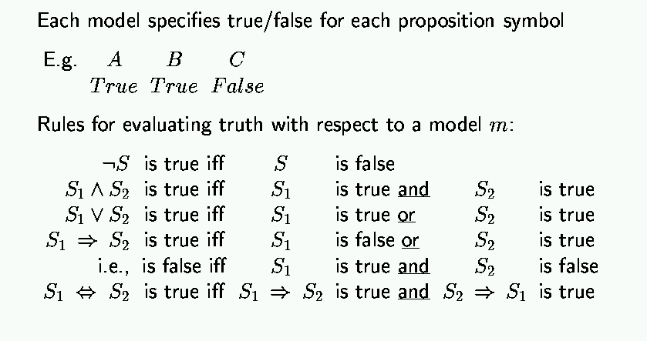
Propositional logic: semantics

Slide 26
Truth tables
Truth value: whether a statement is true or false.
Truth table: complete list of truth values for a statement given all possible values of the individual atomic expressions.
Example:
P Q P V Q
T T T
T F T
F T T
F F F

Slide 27
Truth tables for basic connectives
P Q ¬P ¬Q P V Q P ^ Q P=>Q P⬄Q
T T F F T T T T
T F F T T F F F
F T T F T F T F
F F T T F F T T

Slide 28
Propositional logic: basic manipulation rules
¬(¬A) = A Double negation
¬(A ^ B) = (¬A) V (¬B) Negated “and”
¬(A V B) = (¬A) ^ (¬B) Negated “or”
A ^ (B V C) = (A ^ B) V (A ^ C) Distributivity of ^ on V
A => B = (¬A) V B by definition
¬(A => B) = A ^ (¬B) using negated or
A ⬄ B = (A => B) ^ (B => A) by definition
¬(A ⬄ B) = (A ^ (¬B))V(B ^ (¬A)) using negated and & or
…

Slide 29
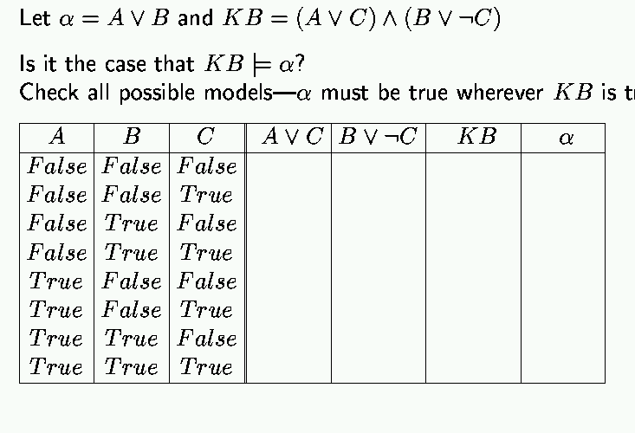
Propositional inference: enumeration method

Slide 30
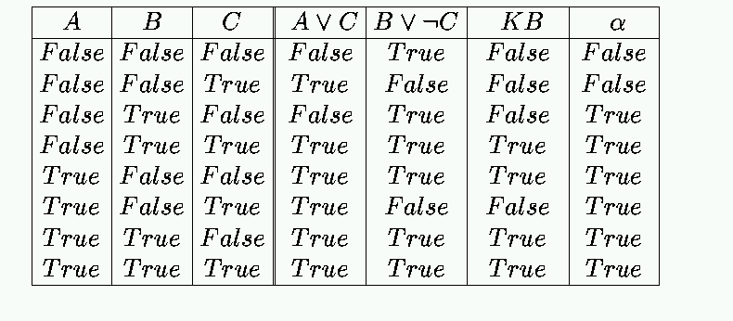
Enumeration: Solution

Slide 31
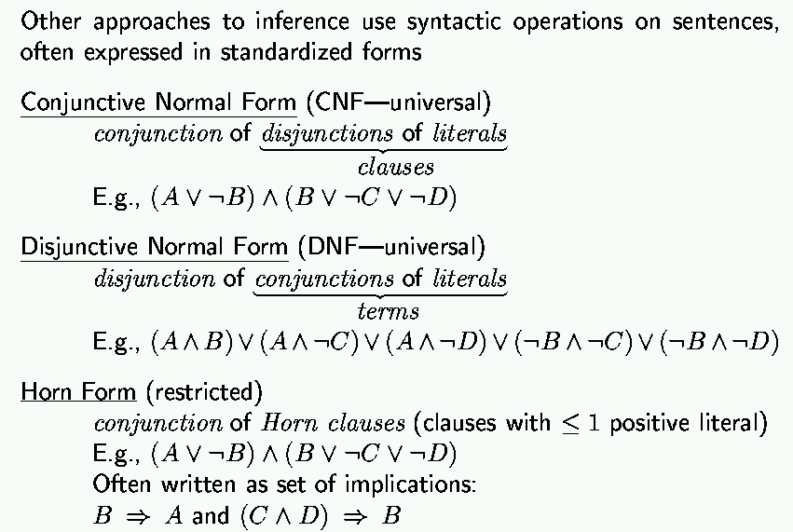
Propositional inference: normal forms
“product of sums of
simple variables or
negated simple variables”
“sum of products of
simple variables or
negated simple variables”

Slide 32
Deriving expressions from functions
Given a boolean function in truth table form, find a propositional logic expression for it that uses only V, ^ and ¬.
Idea: We can easily do it by disjoining the “T” rows of the truth table.
Example: XOR function
P Q RESULT
T T F
T F T P ^ (¬Q)
F T T (¬P) ^ Q
F F F
RESULT = (P ^ (¬Q)) V ((¬P) ^ Q)

Slide 33
A more formal approach
To construct a logical expression in disjunctive normal form from a truth table:
Build a “minterm” for each row of the table, where:
- For each variable whose value is T in that row, include
the variable in the minterm
- For each variable whose value is F in that row, include
the negation of the variable in the minterm
- Link variables in minterm by conjunctions
The expression consists of the disjunction of all minterms.

Slide 34
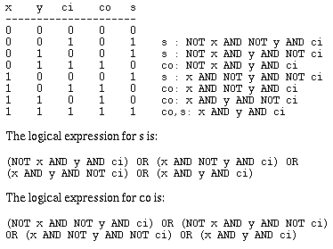
Example: adder with carry
Takes 3 variables in: x, y and ci (carry-in); yields 2 results: sum (s) and carry-out (co). To get you used to other notations, here we assume T = 1, F = 0, V = OR, ^ = AND, ¬ = NOT.
co is:
s is:

Slide 35
Tautologies
Logical expressions that are always true. Can be simplified out.
Examples:
T
T V A
A V (¬A)
¬(A ^ (¬A))
A ⬄ A
((P V Q) ⬄ P) V (¬P ^ Q)
(P ⬄ Q) => (P => Q)

Slide 36
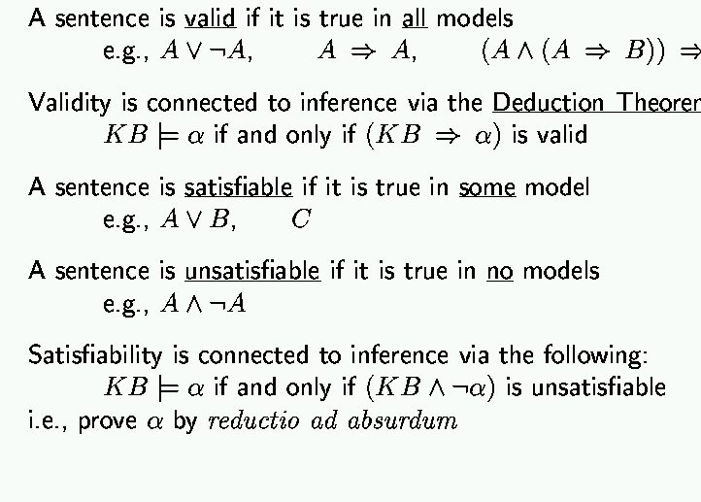
Validity and Satisfiability
Theorem

Slide 37
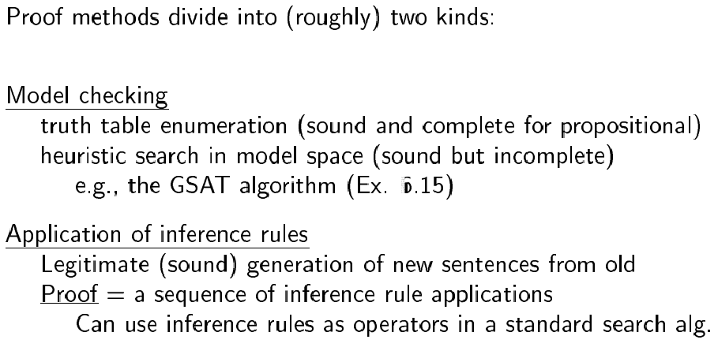
Proof methods

Slide 38
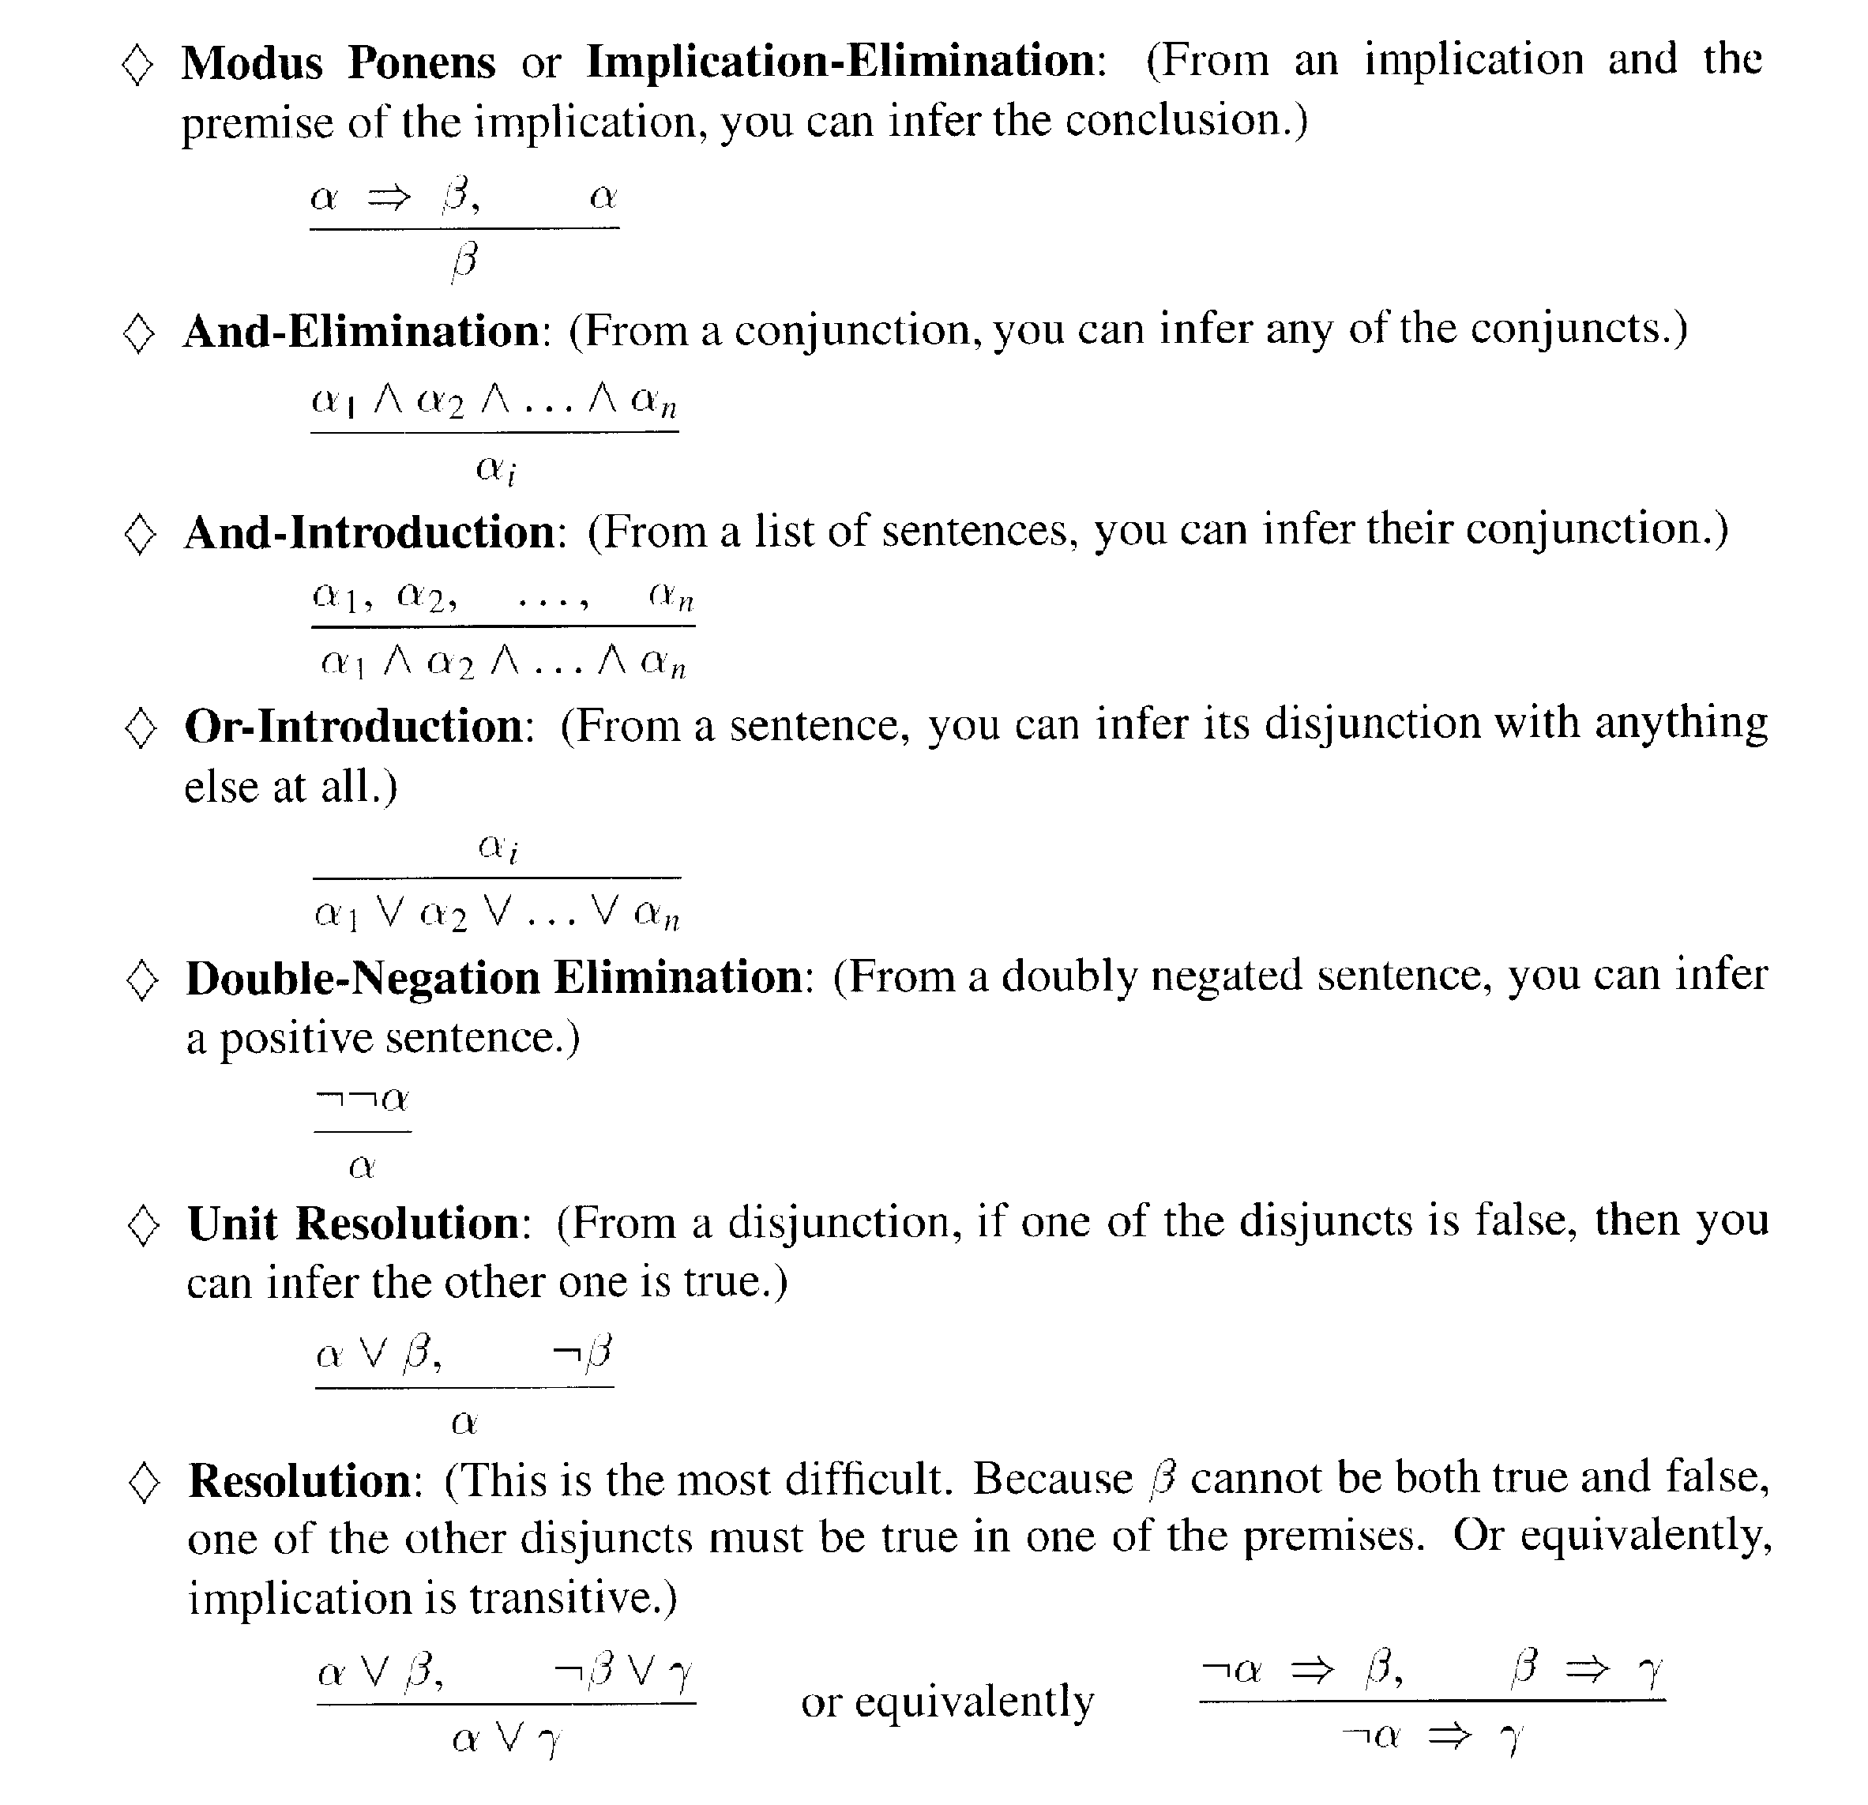
Inference rules

Slide 39
Wumpus world: example
Facts: Percepts inject (TELL) facts into the KB
  [stench at 1,1 and 2,1] → S1,1 ; S2,1
Rules: if square has no stench then neither the square or adjacent square contain the wumpus
  R1: !S1,1 ⇒!W1,1 ∧ !W1,2 ∧ !W2,1
  R2: !S2,1 ⇒!W1,1 ∧!W2,2 ∧ !W2,2 ∧ !W3,1
  …
Inference:
  KB contains !S1,1 then using Modus Ponens we infer
  !W1,1 ∧ !W1,2 ∧ !W2,1
  Using And-Elimination we get: !W1,1 !W1,2 !W2,1
  …

Slide 40
Limitations of Propositional Logic
1. It is too weak, i.e., has very limited expressiveness:
Each rule has to be represented for each situation:
e.g., “don’t go forward if the wumpus is in front of you” takes 64 rules
2. It cannot keep track of changes:
If one needs to track changes, e.g., where the agent has been before then we need a timed-version of each rule. To track 100 steps we’ll then need 6400 rules for the previous example.
Its hard to write and maintain such a huge rule-base
Inference becomes intractable

Slide 41
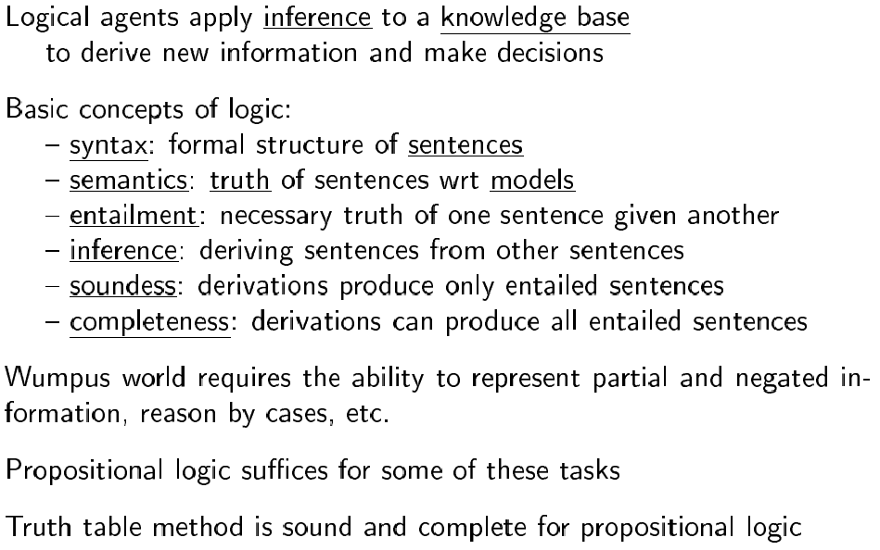
Summary

Slide 42
Next time
First-order logic: Chapter 7

